Slide 1

Predicting Run or Pass probability in NFL game

Slide 2
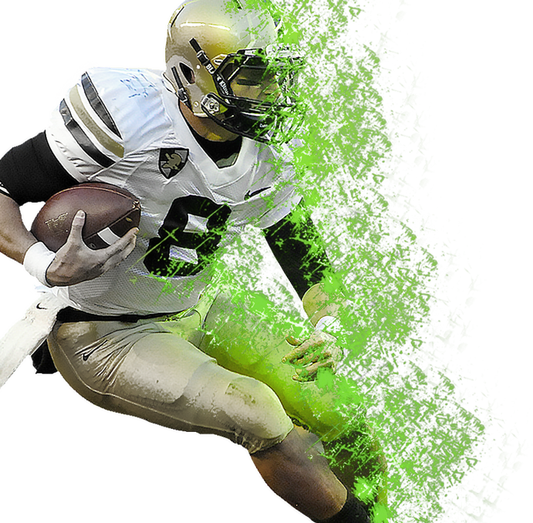
Meet Our Team
Bhagyalakshmi Patchipalu
Ramontal Philemon L
Supervised by
Dr. Sean Mondesire, Ph.D.

Slide 3
Data life cycle
Discovery
Phase 1: Discovery
Phase 2: Data Preparation
Phase 3: Model Planning
Phase 4: Model Building
Phase 5: Communicate Results
Phase 6: Operationalize
Operationalize
Data Preparation
Communicate Results
Model Planning
Model Building

Slide 4
Contents
Problem Statement
Data collection
Design and Implementation
Dependent Variables
Independent Variables
Model/Approach
Correlation
Analysis
Results
References

Slide 5
Problem Statement:
Which play run or pass will lead to greatest probability of success in any given game?
To develop a model for predicting the play type in National Football League (NFL) by using Data Mining and Machine learning techniques.
By using these approaches the most optimal model will be able to provide relative accuracy.

Slide 6
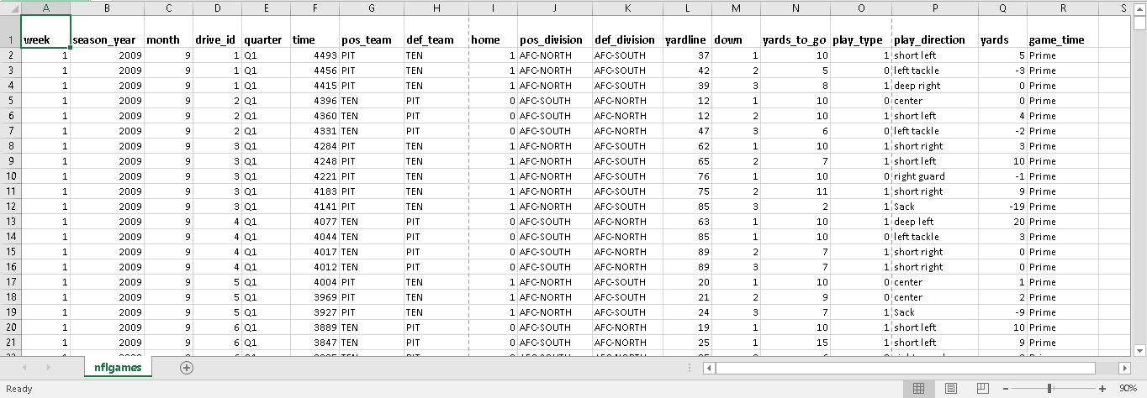
Data Collection:
The data is collected from 2009-2015 to predict play type probability in NFL(National Football League).

Slide 7
Design and Implementation:
To predict probability of play type in NFL game, Machining Learning and Data Mining approach is being used for predicting result(play type) with higher accuracy.
Data Mining techniques: Logistic Regression(LR), Decision Tree Classification
Machine Learning technique: Artificial Neural Network(ANN)
To Implement the design, R language was used to create the model.
Computer languages: R Studio 1.1.463
Libraries: computer languages: R Studio
Libraries: RMySQL, corrplot, h2o (For neural networks), caTools, rpart (decision trees).

Slide 8
Dependent Variables:
Play type
Description: It represents Run or Pass
In an NFL game there are various paly types that occurred during the game. However, the two most
predominant play types are “Run” or “Pass”. We have taken only Run and Pass for analysis.

Slide 9
Independent Variables:
quarter
Description: It represents the time played by quarter
Data type: Numeric
month
Description: It represents the months from September - January
Data type: Numeric
ydstogo
Description: It represents the amount of yards to gain for a first down
Data type: Numeric
Week
Description: It represents week game is played (NFL season has 17 weeks)
Data type: Numeric
Season_year
Description: It represents year in which game is played
Data type: Numeric
drive_id
Description: It represents the drive (possession) number within each game
Data type: Numeric

Slide 10
Independent Variables:
Time
Description: it represents amount of time remaining in a given game
Data type: Numeric
Pos_Team
Description: It represents the team in possession of the ball
Data type: Textual
Pos_division
Description: It represents division of offensive team
Data type: Textual
Def_Team
Description: It represents the defensive team
Data type: Textual
Def_division
Description: It represents division of defensive team
Data type: Textual
YardLine
Description: It represents Yard line on the 100 yard field where the ball is located
Data type: Numeric

Slide 11
Independent Variables:
Down
Description: 1-4 opportunities for team in possession of the ball
Data type: Numeric
Play_direction
Description: It represents the direction in which play is made on the field
Data type: Textual
Yards
Description: It represents yards gained or lost on any given play
Data type: Numeric
Game_time
Description: It represents if the game is played on regular time or prime time
Data type: Textual
home
Description: It represents home team
Data type: Numeric

Slide 12
Model/Approach:
For Predicting results four models were used, they include Logistic Regression, Decision Tree Classification and Artificial Neural Network(ANN) however, the most optimal model was proven to be Decision Tree with 75% for Predicting probability of Play type.

Slide 13
Training set:
Data set is split in to 80% to create the training set i.e (171,108 rows of 18 variables), because subsample random selections of the training data, train the classifier and record the performance on the validation set.
Testing set:
Data set is split in to 20% to create the testing set i.e (42,777 rows of 19 variables), because the models performance statistic will have greater variance.

Slide 14
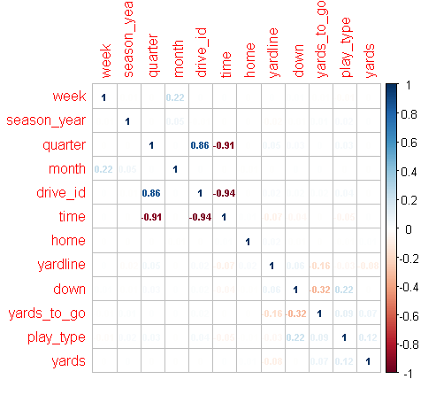
Correlation:

Slide 15
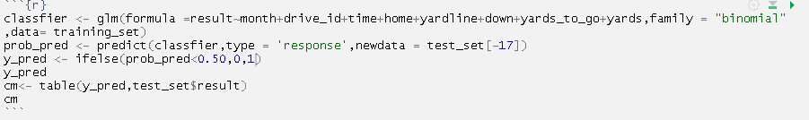
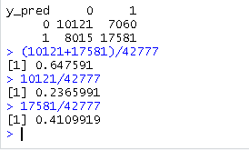
Analysis: Logistic regression
Result

Slide 16
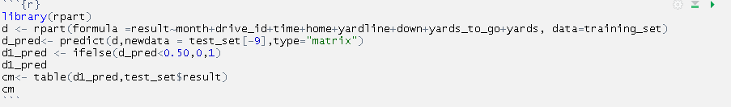
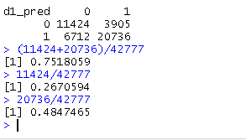
Analysis: Decision Tree
Result

Slide 17
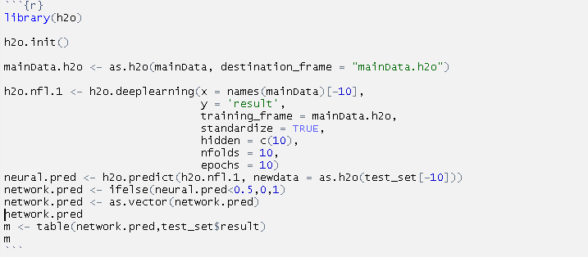
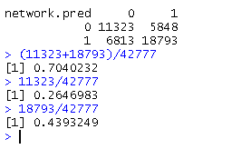
Analysis: ANN
Result

Slide 18
Result:
MODEL | RUN & PASS (%) | RUN (%) | PASS (%)
LOGISTIC | 64.75 | 41.09 | 23.65
DECISION TREE | 75.18 | 48.47 | 26.70
ANN | 70.40 | 43.93 | 26.43
MIXED | 70.11 | 44.49 | 25.59

Slide 19
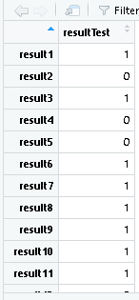
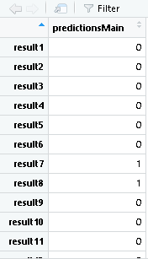
Based on Logistic Regression, the paly type has been predicted with 64.6% accuracy.
Actual result
Predicted result
AccuracyRate 0.6461884
Accurate samples =25319

Slide 20
Prescription:
Based on the models produced the statistical analysis prescribes NFL defenses should play the run twice as often as they play the pass. The probability of a run averages out to about 45% while the probability of a pass is about 26%. Thus the game plan should be geared toward stopping the run.
Conversely, based on the models produced the statistical analysis prescribes that NFL offences vary their attack. The run pass options should be more balanced in order to keep the defense guessing.

Slide 21
References:
Pablo Bosch.(February 2018). Predicting the winner of NFL-games using Machine and Deep Learning.
Retrieved from https://beta.vu.nl/nl/Images/werkstuk-bosch_tcm235-888637.pdf
Zachary Owen and Virgile Galle.(2017). Predicting the NFL.
Retrieved from https://docplayer.net/56085578-Predicting-the-nfl-zachary-owen-and-virgile-galle.html
Austin Grosel. Predicting NFL Coaching and Team Based Play Calls
Orr, Connor. “NFL's Most, Least Balanced Offensive Play-Callers.” NFL.com ,
Retrieved from www.nfl.com/news/story/0ap3000000816875/article/nfls-most-least-balanced-offensive-play
callers .
Jones, Willie D.(August 2015). Model Predicts Whether NFL Teams Will Run or Pass.
IEEE Spectrum: Technology, Engineering, and Science News.
Retrieved from spectrum.ieee.org/tech-talk/geek-life/tools-toys/statistical-model-predicts-whether-nfl-teams-will- run-or-pass.

Slide 22
Thank you

Slide 23
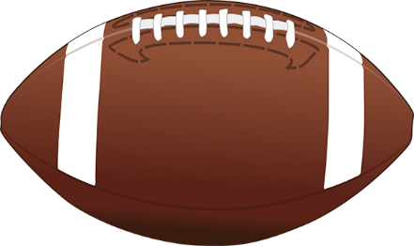
Any Queries?

